Slide 1
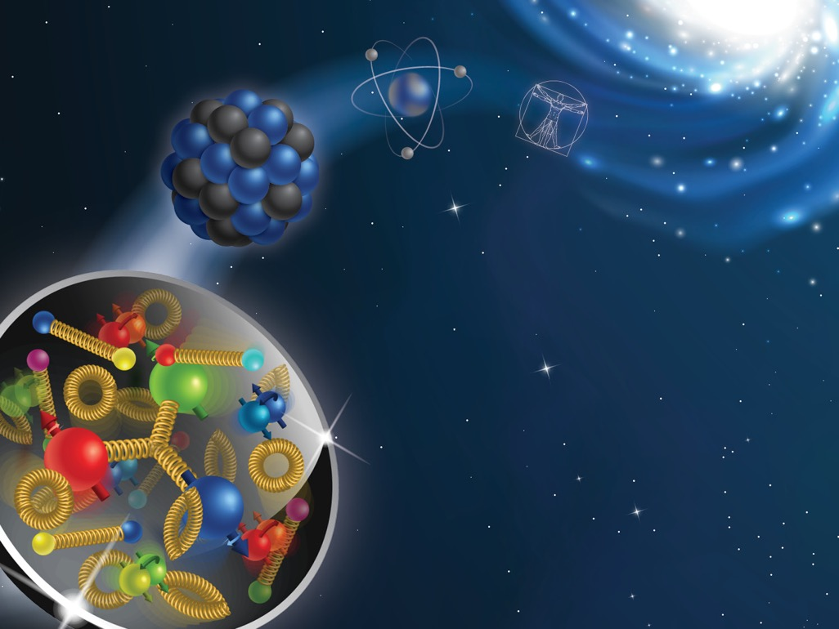
Phenomenology of TMDs: lecture III
Alexei Prokudin

Slide 2
The plan:
Lecture I:
Structure of the nucleon
Transverse Momentum Dependent distributions (TMDs)
Lecture III
Semi Inclusive Deep Inelastic Scattering (SIDIS)
Calculations of SIDIS structure functions using Mathematica

Slide 3
Semi Inclusive Deep Inelastic Scattering (SIDIS)

Slide 4
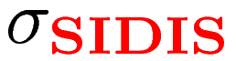
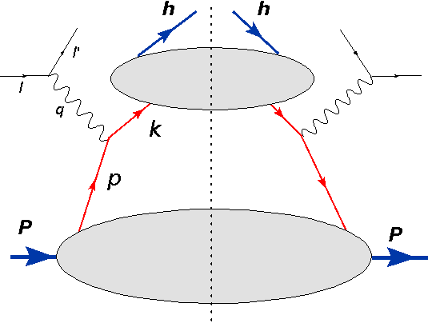
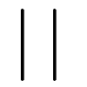
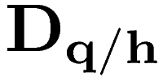

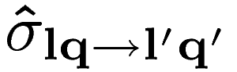
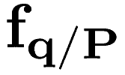
Factorization
Fragmentation
Distribution

Slide 5
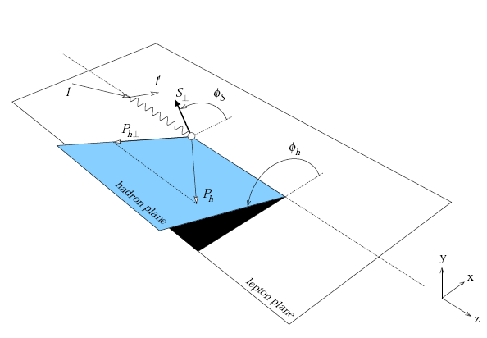
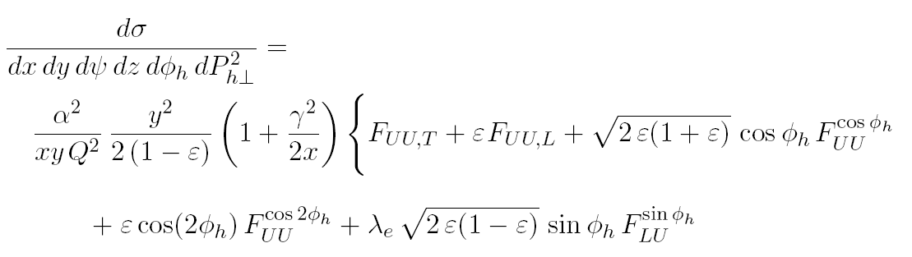

Semi Inclusive Deep Inelastic scattering
One can rewrite the cross-section in terms of 18 structure functions
Each structure function encodes parton dynamics via convolutions of TMDs when factorization is applicable
Mulders, Tangerman (1995),
Boer, Mulders (1998)
Bacchetta et al (2007)

Slide 6
Semi Inclusive Deep Inelastic scattering
One can rewrite the cross-section in terms of 18 structure functions
Each structure function encodes parton dynamics via convolutions of TMDs when factorization is applicable
Mulders, Tangerman (1995),
Boer, Mulders (1998)
Bacchetta et al (2007)

Slide 7
Semi Inclusive Deep Inelastic scattering
One can rewrite the cross-section in terms of 18 structure functions
Each structure function encodes parton dynamics via convolutions of TMDs when factorization is applicable
Mulders, Tangerman (1995),
Boer, Mulders (1998)
Bacchetta et al (2007)
The TMD factorization is valid in the region
Final transverse momentum is related to transverse momenta of parent and
fragmenting partons

Slide 8
Cross-section
Bacchetta et al (2007)
virtual photon polarization
beam polarization
beam polarization
beam polarization
Target polarization
longitudinal
transverse
Longitudinal to transverse photon flux ratio

Slide 9
Cross-section
Bacchetta et al (2007)
Asymmetry
Angular dependence
Beam Target
Polarization

Slide 10
What do we know about structure functions in SIDIS?

Slide 11
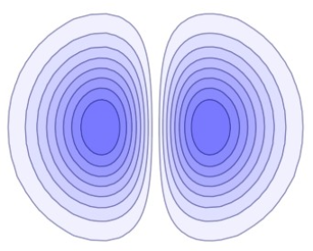
Sivers function
Non universal
Collins function
Universal

Slide 12
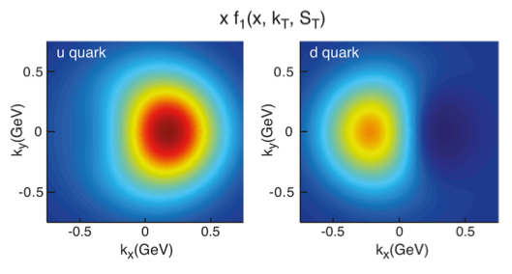
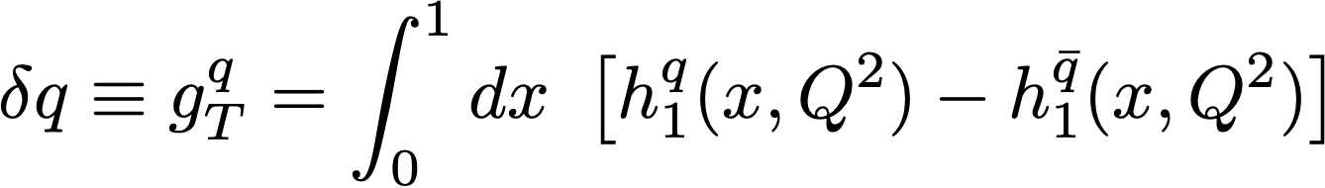
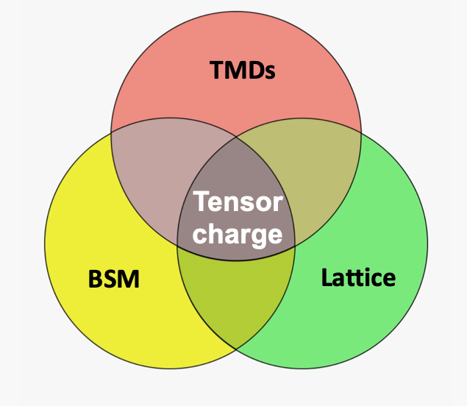
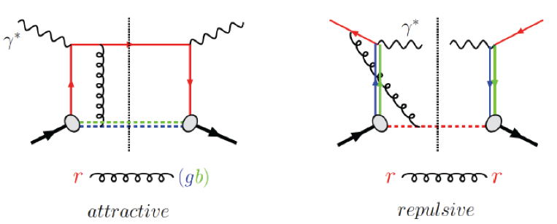
h
Sivers function
Transversity
Describes unpolarized quarks inside of transversely polarized nucleon
Encodes the correlation of orbital motion with the spin
The only source of information on tensor charge of the nucleon
Couples to Collins fragmentation function or di-hadron interference fragmentation functions in SIDIS
Sign change of Sivers function is fundamental consequence of QCD
Brodsky, Hwang, Schmidt (2002), Collins (2002)

Slide 13
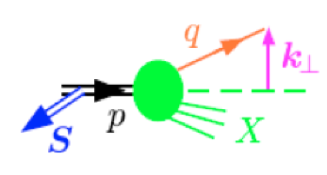
Definitions
Sivers function: unpolarized quark distribution inside a transversely
polarized nucleon
Sivers 1989
Spin independent
Spin dependent
Collins function: unpolarized hadron from a transversely polarized quark
Collins 1992

Slide 14
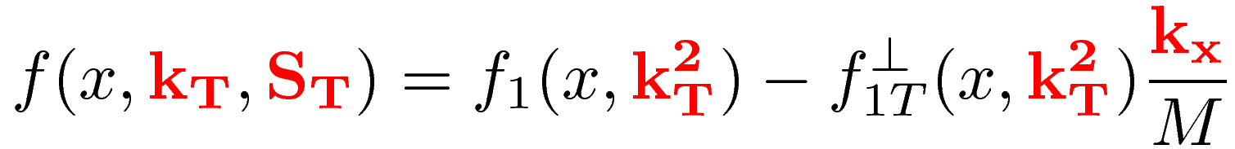
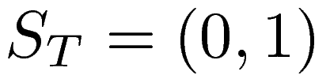
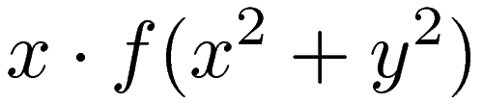
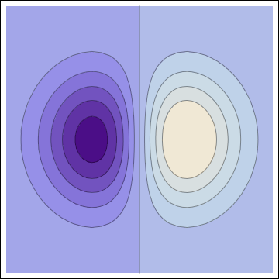
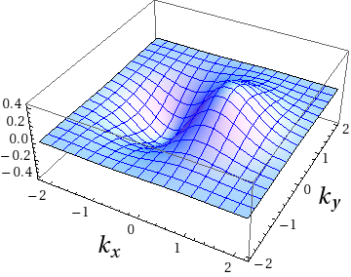
Suppose the spin is along Y direction:
Deformation in momentum space is:
This is the “dipole” deformation.

Slide 15
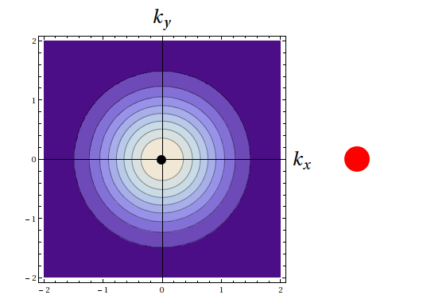
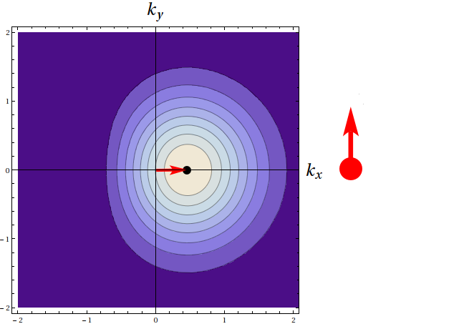
Suppose the spin is along Y direction:
Deformation in momentum space is:
This is the “dipole” deformation.
No correlation:
Correlation:

Slide 16
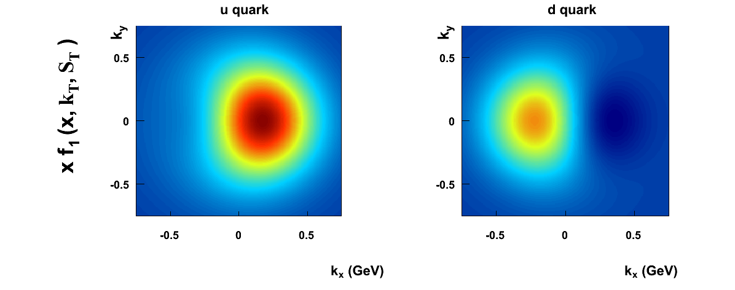
Tomographic scan of the nucleon
Anselmino et al 2009

Slide 17
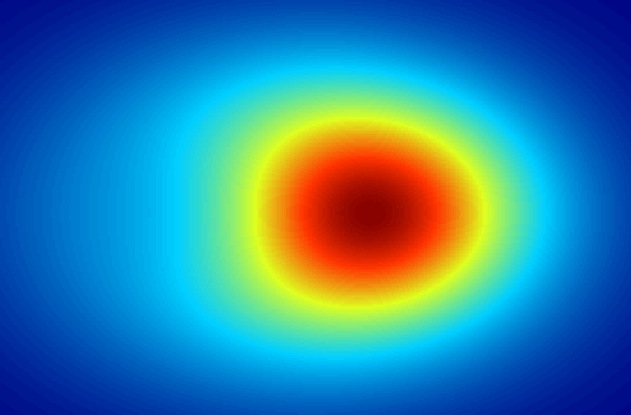
Tomographic scan of the nucleon
SPIN
Internal motion of quarks is correlated with the spin of the proton!

Slide 18
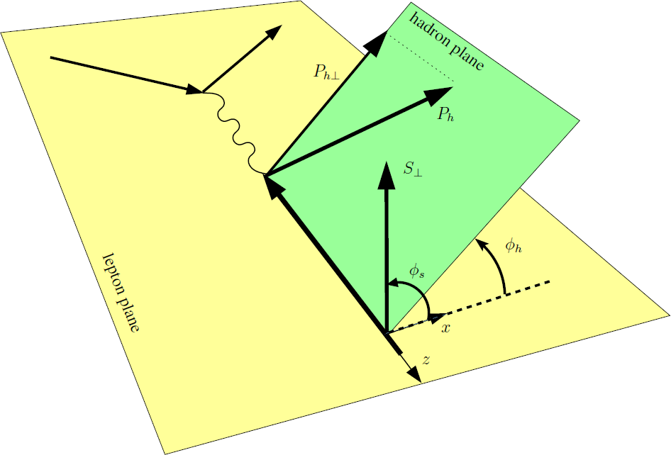
Definitions
Sivers function: describes strength of correlation
Sivers 1989
Collins function: describes strength of correlation
Collins 1992
Both functions extensively studied experimentally, phenomenologically,
theoretically
Sivers function and Collins function can give rise to Single Spin Asymmetries in scattering processes. For instance in Semi Inclusive Deep Inelastic process
Kotzinian (1995),
Mulders,
Tangerman (1995),
Boer, Mulders (1998)

Slide 19
Sivers function
Large – N_{c} result
Confirmed by phenomenological extractions
Confirmed by experimental measurements
Pobylitsa 2003
Relation to GPDs (E) and anomalous magnetic moment
Predicted correct sign of Sivers asymmetry in SIDIS
Shown to be model-dependent
Used in phenomenological extractions
Burkardt 2002
Meissner, Metz, Goeke 2007
Bacchetta, Radici 2011

Slide 20
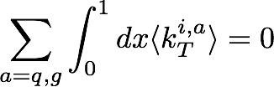
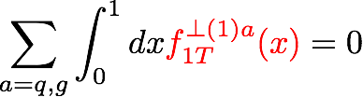
Sivers function
Sum rule
Conservation of transverse momentum
Average transverse momentum shift of a quark inside a transversely
polarized nucleon
Sum rule
Burkardt 2004

Slide 21
Sivers function
Extractions
Many extractions without taking into account TMD evolution
Extractions with TMD evolution
Relation to the tomography of the nucleon
Agreement with the sum rule and large N_{c} prediction
Efremov et al 2005, Vogelsang, Yuan 2005, Anselmino et al 2005,
Collins et al 2006, Anselmino et al 2009, 2011, 2016, Bacchetta Radici 2011, Cammarota et al 21
Echevarria et al 2014, Sun Yuan 2013,
Del Carro et al 21,
Echevarria, Kang, Terry 21, AP, Vladimirov 21
Anselmino et al 2009

Slide 22

Sign change of Sivers function
Colored objects are surrounded by gluons, profound consequence of gauge invariance:
Sivers function has opposite sign when gluon couple after quark scatters (SIDIS) or before quark annihilates (Drell-Yan)
Crucial test of TMD factorization and collinear twist-3 factorization
Several labs worldwide aim at measurement of Sivers effect in Drell-Yan
BNL, CERN, GSI, IHEP, JINR, FERMILAB etc
Barone et al., Anselmino et al., Yuan,Vogelsang, Schlegel et al., Kang,Qiu, Metz,Zhou etc
The verification of the sign change is an NSAC (DOE and NSF) milestone
Brodsky,Hwang,Schmidt;
Belitsky,Ji,Yuan;
Collins;
Boer,Mulders,Pijlman;
Kang, Qiu;
Kovchegov, Sievert;
etc

Slide 23
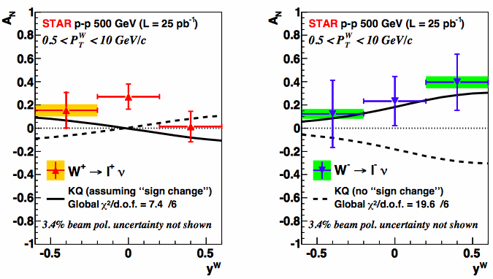
Process dependence of Sivers function
First experimental hint on the sign change: A_{N} in W and Z production
Sign change
No sign change
STAR 2016
STAR Collab. Phys. Rev. Lett. 116, 132301 (2016)
KQ → Kang, Qiu 2009
Large uncertainties of predictions
No antiquark Sivers functions

Slide 24
Process dependence of Sivers function
First experimental hint on the sign change in Drell-Yan
Sign change
No sign change
COMPASS 2017
COMPASS results hint on sign change

Slide 25
Collins function
Schafer-Teryaev sum rule
Conservation of transverse momentum
Sum rule
If only pions are considered
Schafer Teryaev 1999
Meissner, Metz, Pitonyak 2010
Universality of TMD fragmentation functions
Very non trivial results
Agrees with phenomenology, allows global fits
Metz 2002, Metz, Collins 2004, Yuan 2008
Gamberg, Mukherjee, Mulders 2011
Boer, Kang, Vogelsang, Yuan 2010
\

Slide 26
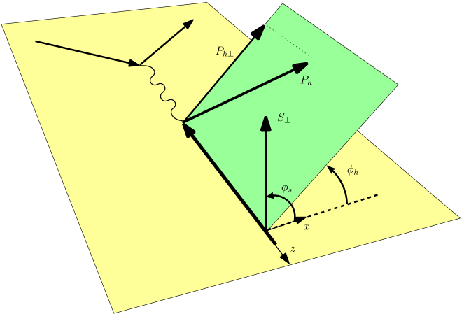
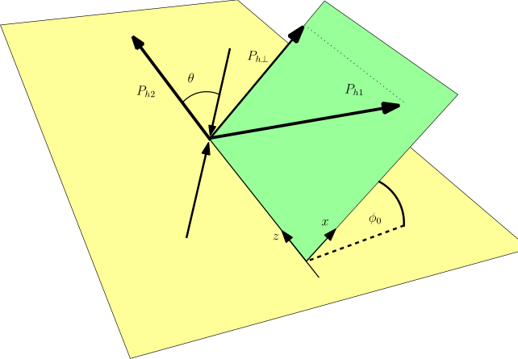
Transversity and Collins FF
SIDIS and e+e-: combined global analysis
transversity
Collins function
Collins function
Collins function

Slide 27
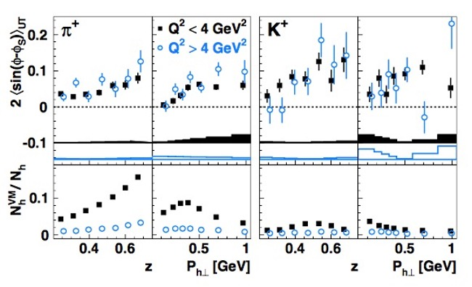
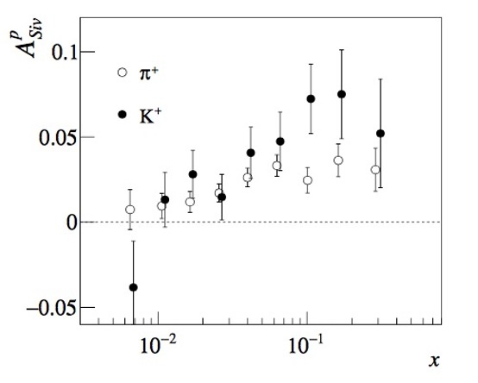
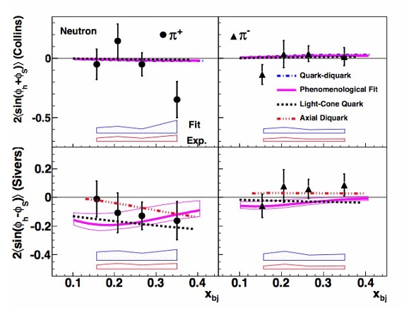
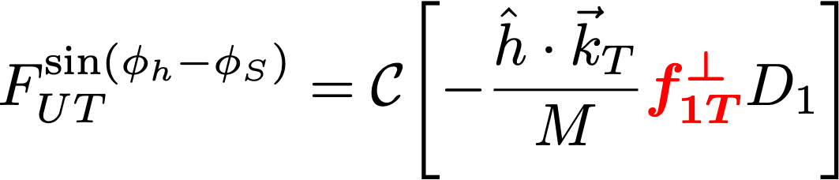
TRANSVERSE SPIN asymmetries
Transverse Single Spin Asymmetries (SSAs) have been observed in a variety of processes
Sivers asymmetry in SIDIS
HERMES (09)
COMPASS (15)
JLAB (11)

Slide 28
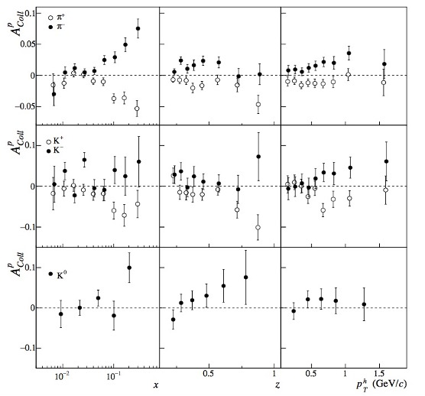
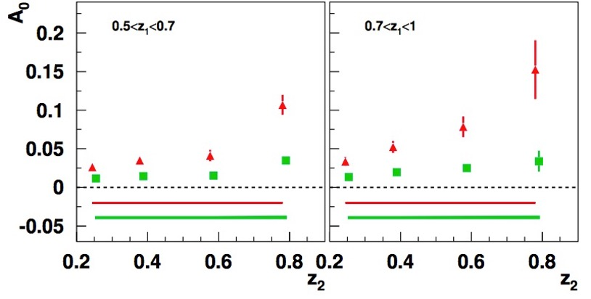
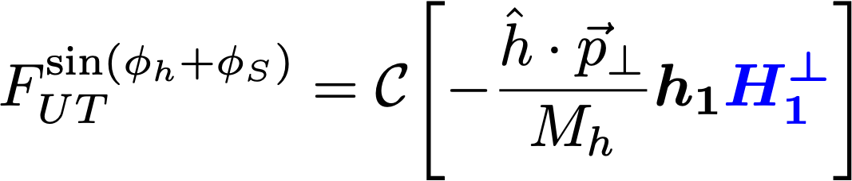
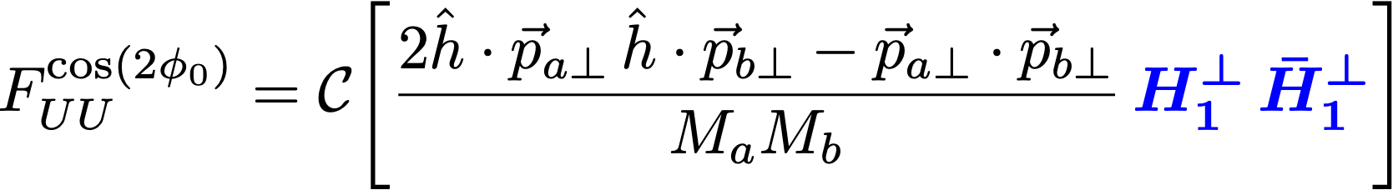
TRANSVERSE SPIN asymmetries
Transverse Single Spin Asymmetries (SSAs) have been observed in a variety of processes
Collins asymmetry in SIDIS and e⁺e⁻
BELLE (08),
also BaBar (14), BESIII (16)
COMPASS (15),
also HERMES (05,10, 20), JLab (11,14)

Slide 29
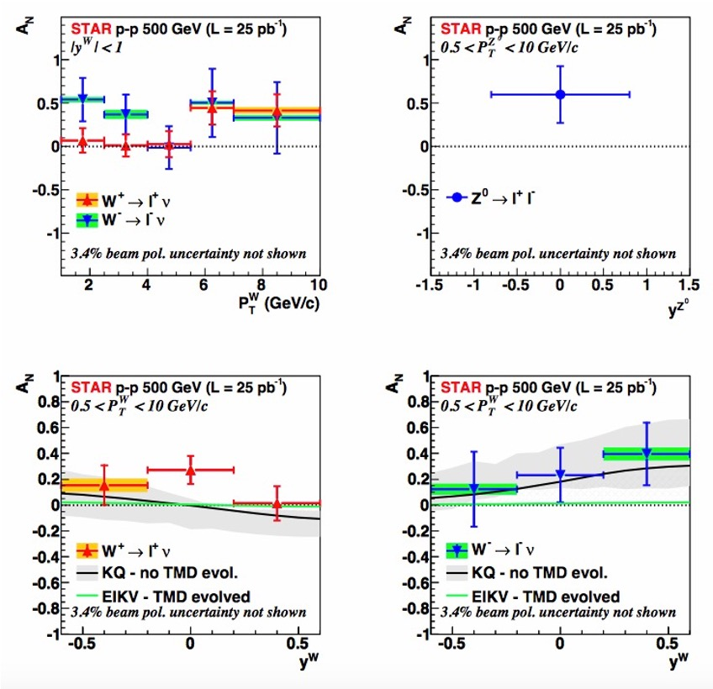
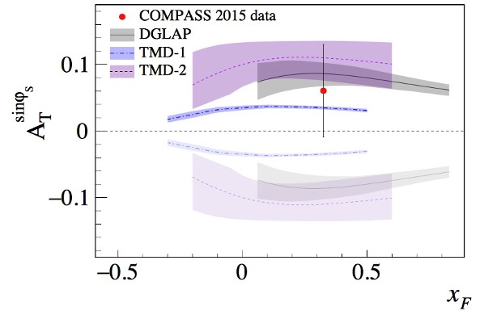
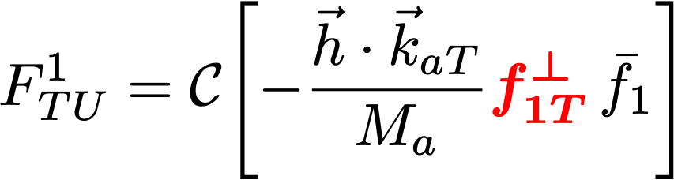
TRANSVERSE SPIN asymmetries
Transverse Single Spin Asymmetries (SSAs) have been observed in a variety of processes
Sivers effect in Drell-Yan
COMPASS (17)
STAR (15)

Slide 30
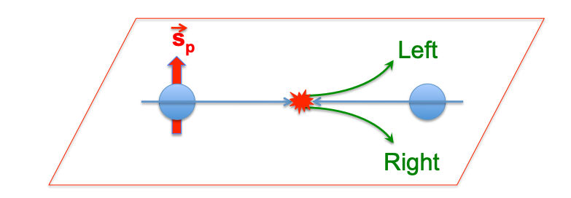
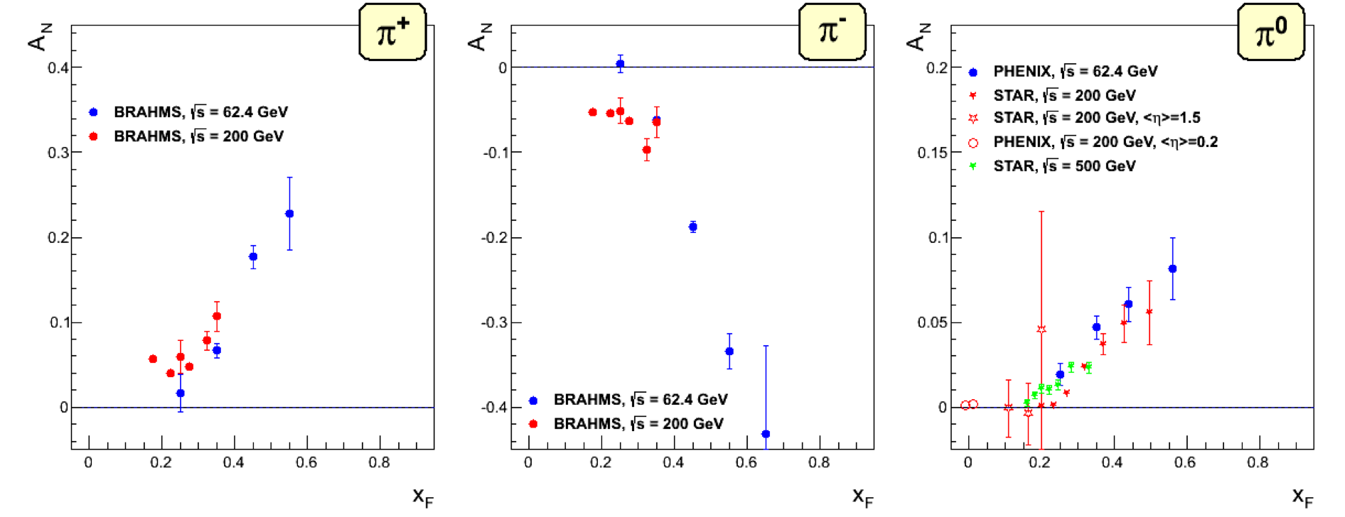
TRANSVERSE SPIN asymmetries
AN in pp scattering
RHIC: STAR, BRAHMS, PHENIX
“The RHIC SPIN Program: Achievements and Future Opportunities”, Aschenauer et al (15)

Slide 31
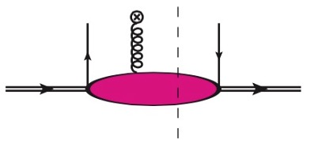

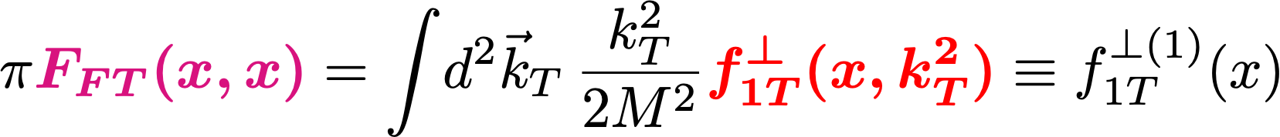
TRANSVERSE SPIN asymmetries
AN in pp scattering is related to
collinear twist-3 (CT3) factorization
Qiu-Sterman term
quark-gluon-quark correlator
Qiu, Sterman (99), Kouvaris, et al (06)
the first moment of Sivers function
Boer, et al (03)
TMD and CT3 factorization agree in their overlapping region of applicability
Ji, et al (06); Koike, et a. (08); Zhou, et al (08, 10); Yuan and Zhou (09)

Slide 32
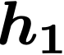
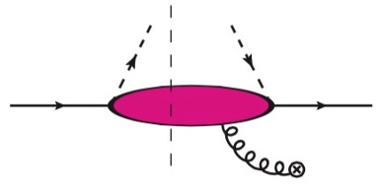


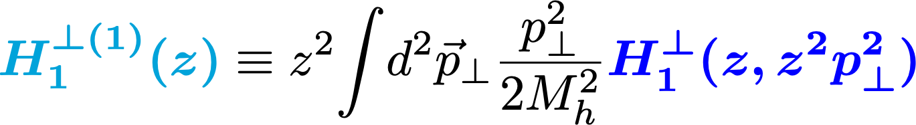
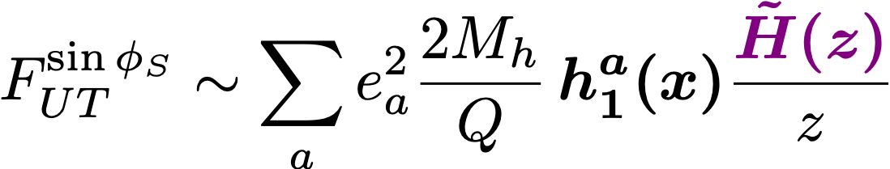
TRANSVERSE SPIN asymmetries
AN in pp scattering is related to
collinear twist-3 (CT3) factorization
Fragmentation term
collinear transversity
Kanazawa, Koike, Metz, Pitonyak, Schlegel, (16)
~
quark-gluon-quark fragmentation functions
the first moment of Collins FF
Mulders, Tangerman (96); Bacchetta, et al (07)

Slide 33
JAM20 analysis
Cammarota, Gamberg, Kang, Miller, Pitonyak, Prokudin, Rogers, Sato (2020)

Slide 34



UNIVERSAL GLOBAL FIT 2020
Cammarota, Gamberg, Kang, Miller, Pitonyak, Prokudin, Rogers, Sato (2020)
e⁺e–
Drell-Yan and W,Z
electron
pion
proton
electron
To demonstrate the common origin of SSAs in various processes, we combined all available data and extracted a universal set of non perturbative functions that describes all of them
pion
positron
Collins asymmetries
BELLE, BaBar, BESIII data
positron
proton
Sivers asymmetries
COMPASS, STAR data
SIDIS
lepton
lepton
PP
proton
pion
pion
proton
proton
Sivers, Collins asymmetries
COMPASS, HERMES, JLab data
AN asymmetry
STAR, PHENIX, BRAHMS data

Slide 35
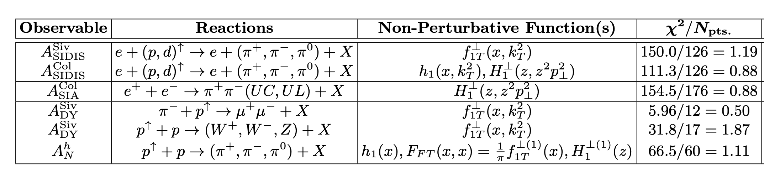

UNIVERSAL GLOBAL FIT 2020
Jefferson Lab Angular Momentum Collaboration
https://www.jlab.org/theory/jam
Cammarota, Gamberg, Kang, Miller, Pitonyak, Prokudin, Rogers, Sato (2020)
18 observables and 6 non-perturbative functions (Sivers up/down; transversity up/down; Collins favored/unfavored)
Broad kinematical coverage to test universality
The analysis is performed at parton level leading order, gaussian model is used for TMDs, and DGLAP-type evolution is implemented

Slide 36




UNIVERSAL GLOBAL FIT 2020
Cammarota, Gamberg, Kang, Miller, Pitonyak, Prokudin, Rogers, Sato (2020)
Transversity
Sivers
Collins FF

Slide 37



UNIVERSAL GLOBAL FIT 2020
Cammarota, Gamberg, Kang, Miller, Pitonyak, Prokudin, Rogers, Sato (2020)
SIDIS
Collins asymmetry
Sivers asymmetry

Slide 38


UNIVERSAL GLOBAL FIT 2020
Cammarota, Gamberg, Kang, Miller, Pitonyak, Prokudin, Rogers, Sato (2020)
e⁺e⁻

Slide 39



UNIVERSAL GLOBAL FIT 2020
Cammarota, Gamberg, Kang, Miller, Pitonyak, Prokudin, Rogers, Sato (2020)
Drell-Yan
STAR
COMPASS DY

Slide 40


UNIVERSAL GLOBAL FIT 2020
Cammarota, Gamberg, Kang, Miller, Pitonyak, Prokudin, Rogers, Sato (2020)
proton-proton AN

Slide 41






UNIVERSAL GLOBAL FIT 2020
Cammarota, Gamberg, Kang, Miller, Pitonyak, Prokudin, Rogers, Sato (2020)
Tensor charge from up and down quarks
is constrained and compatible with lattice
results
𝜹u and 𝜹d Q²=4 GeV²
𝜹u= 0.65 0.22
𝜹d= -0.24 0.2
$$±$$
$$±$$
Isovector tensor charge gT = 𝜹u-𝜹d
gT = 0.89 0.12 compatible with lattice results
$$±$$

Slide 42






Complementarity of SIDIS, e+e- and Drell-Yan, and hadron-hadron
Various processes allow study and test of evolution, universality and extractions of distribution and fragmentation functions. We need information from all of them
Semi Inclusive DIS –
convolution of distribution functions and fragmentation functions
Drell-Yan – convolution of distribution functions
e+ e- annihilation – convolution of
fragmentation functions
Hadron-hadron – convolutions of PDF and fragmentation functions
Combining measurements from all above is important
Alexei Prokudin

Slide 43
Why TMDs, factorization, and evolution

Slide 44


Why QCD evolution is interesting?
Study of evolution gives us insight on different aspects and origin of confined motion of partons, gluon radiation, parton fragmentation
Confined motion
Gluon shower
Emergence of a hadron
hadronization
Evolution allows to connect measurements at very different scales.
TMD evolution has also a universal non-perturbative part. The result of evolution cannot be uniquely predicted using evolution equations until the non-perturbative part is reliably extracted from the data.

Slide 45









TMD factorization in a nut-shell
Drell-Yan:
Factorized form and mimicking “parton model”
Factorization of regions:
(1) k//P₁, (2) k//P₂, (3) k soft, (4) k hard
mimic “parton model”
slide courtesy of Z. Kang

Slide 46












TMDs evolve
Just like collinear PDFs, TMDs also depend on the scale of the probe = evolution
Collinear PDFs
TMDs
DGLAP evolution
Resum
Kernel: purely perturbative
Collins-Soper/rapidity evolution equation
Resum
Kernel: can be non-perturbative when
slide courtesy of Z. Kang

Slide 47
TMD evolution and non-perturbative component
Fourier transform back to the momentum space, one needs the whole b region (large b): need some non-perturbative extrapolation
Many different methods/proposals to model this non-perturbative part
Eventually evolved TMDs in b-space
Collins, Soper, Sterman 85, ResBos, Qiu, Zhang 99, Echevarria, Idilbi, Kang, Vitev, 14,
Aidala, Field, Gamberg, Rogers, 14, Sun, Yuan 14, D’Alesio, Echevarria, Melis, Scimemi, 14, Rogers, Collins, 15, Vladimirov, Scimemi 17…
longitudinal/collinear part
transverse part
Non-perturbative: fitted from data
The key ingredient – ln(Q) piece is spin-independent
Since the polarized scattering data is still limited kinematics, we can use unpolarized data to constrain/extract key ingredients for the non-perturbative part

Slide 48
TMD
TMD factorization has a validity region
(two scale problem)
In order to describe cross section in a wide region of transverse momentum one needs to add a Y term
Improved approach that aims to describe low-Q region:
Collins, Gamberg, AP, Rogers, Sato, Wang arXiv:1605.00671

Slide 49
TMD related studies have been extremely active in the past few years, lots of progress have been made
We look forward to the future experimental results from COMPASS, RHIC, Jefferson Lab, LHC, Fermilab, future Electron Ion Collider
Many TMD related groups are created throughout the world:
Italy, Netherlands, Belgium, Germany, Japan, China, Russia, and the USA

